Slide 1
Chapter 20: SOUND

Slide 2
This lecture will help you understand:
Nature of Sound
Origin of Sound
Sound in Air
Media That Transmit Sound
Speed of Sound in Air
Reflection of Sound
Refraction of Sound
Energy in Sound Waves
Forced Vibrations
Natural Frequency
Resonance
Interference
Beats

Slide 3
Nature of Sound
Sound is a form of energy that exists whether or not it is heard.

Slide 4
Origin of Sound
Most sounds are waves produced by the vibrations of matter.
For example:
In a piano, a violin, and a guitar, the sound is produced by the vibrating strings;
in a saxophone, by a vibrating reed;
in a flute, by a fluttering column of air at the mouthpiece;
in your voice due to the vibration of your vocal chords.

Slide 5
Origin of Sound
The original vibration stimulates the vibration of something larger or more massive, such as
  the sounding board of a stringed instrument,
  the air column within a reed or wind instrument, or
  the air in the throat and mouth of a singer.
This vibrating material then sends a disturbance through the surrounding medium, usually air, in the form of longitudinal sound waves.

Slide 6
Origin of Sound
Under ordinary conditions, the frequencies of the vibrating source and sound waves are the same.
The subjective impression about the frequency of sound is called pitch.
The ear of a young person can normally hear pitches corresponding to the range of frequencies between about 20 and 20,000 Hertz.
As we grow older, the limits of this human hearing range shrink, especially at the high-frequency end.

Slide 7
Origin of Sound
Sound waves with frequencies below 20 hertz are infrasonic (frequency too low for human hearing).
Sound waves with frequencies above 20,000 hertz are called ultrasonic (frequency too high for human hearing).
We cannot hear infrasonic and ultrasonic sound.

Slide 8
What is the wavelength of a 340-Hz tone in air? What is the wavelength of a 34,000-Hz ultrasonic wave in air?
Wavelength = speed/frequency = 340 m/s / 340 hz = 1 m.
For a 34,000 hertz wave; 340/34,000 = 0.01 m = 1 cm.
2. For years, marine scientists were mystified by sound waves detected by underwater microphones in the Pacific Ocean. These so-called T-waves were among the purest sounds in nature. Eventually they traced the source to underwater volcanoes whose rising columns of bubbles resonated like organ pipes. What is the wavelength of a typical T-wave whose frequency is 7Hz? (The speed of sound in seawater is 1530 m/s.)
λ = v/f = (1530 m/s)/7 Hz = 219 m

Slide 9
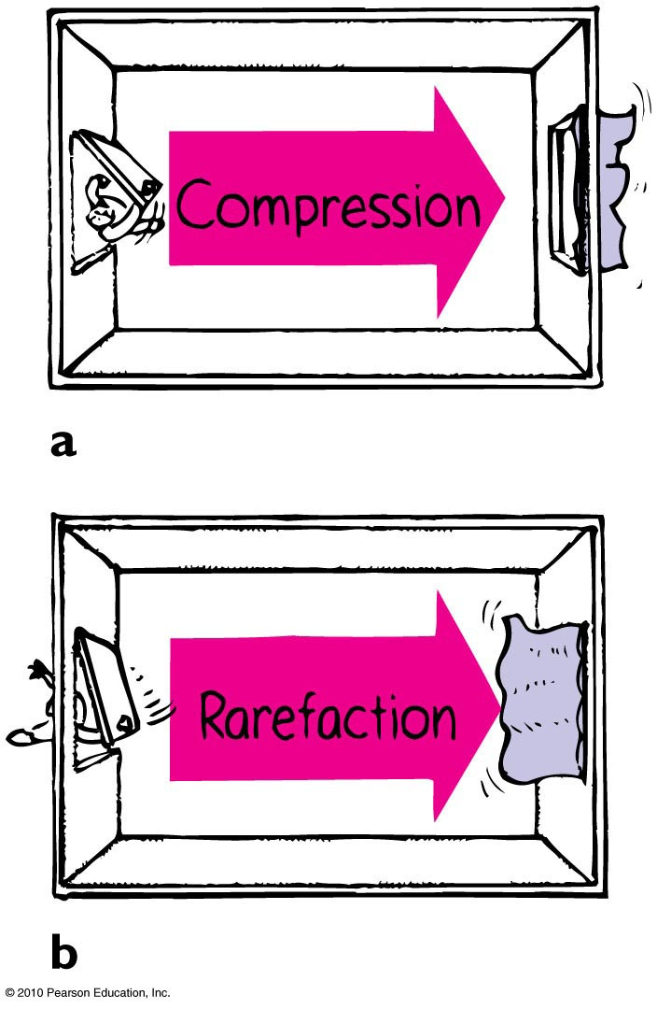
Sound in Air
Sound waves
are vibrations made of compressions and rarefactions.
are longitudinal waves.
require a medium.
travel through solids, liquids, and gases.

Slide 10
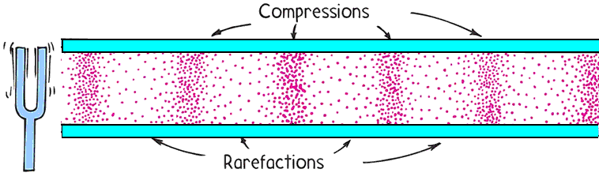
Sound in Air
Wavelength of sound
Distance between successive compressions or rarefactions

Slide 11
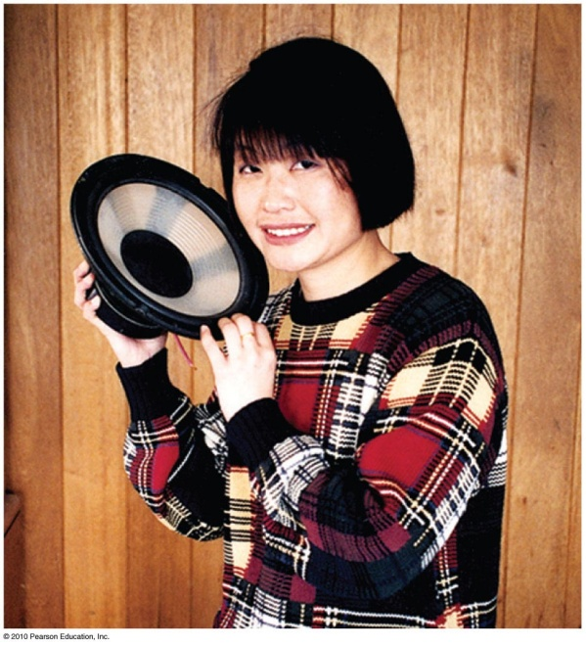
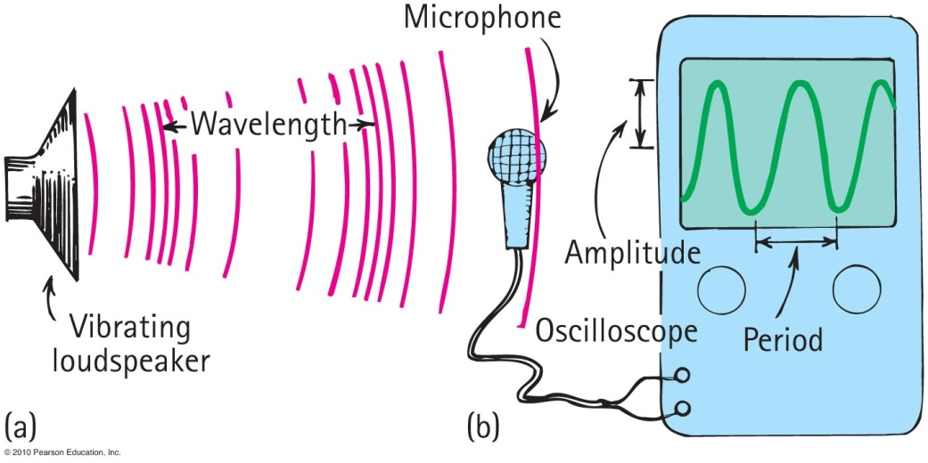
Sound in Air
How sound is heard from a radio loudspeaker
  Radio loudspeaker is a paper cone that vibrates.
  Air molecules next to the loudspeaker set into vibration.
  Produces compressions and rarefactions traveling in air.
  Sound waves reach your ears, setting your eardrums into vibration.
  Sound is heard.

Slide 12
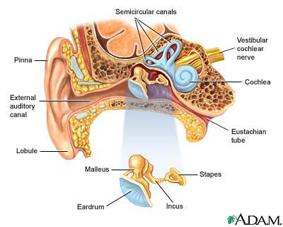
Nature of Sound in Air
The eardrum and the three tiny bones conduct sound from the eardrum to the cochlea which sends electrical pulses to the brain that interprets the sound

Slide 13
4. A bat flying in a cave emits a sound and receives its
echo 0.1 s later. How far away is the cave wall?
Distance = speed x time = 340 m/s x 0.01 / 2 s = 17 m.
6. Imagine a Rip van Winkle type who lives in the
mountains. Just before going to sleep, he yells,
"WAKE UP," and the sound echoes off the nearest
mountain and returns 8 hours later. How far away is
that mountain?
Distance = speed x time = 340 m/s x 8 hr x 3600 s/hr / 2
Distance = 4,896,000 m or 4,900 km

Slide 14
Media That Transmit Sound
Any elastic substance — solid, liquid, gas, or plasma — can transmit sound.
In elastic liquids and solids, the atoms are relatively close together, respond quickly to one another’s motions, and transmit energy with little loss.
Sound travels about 4 times faster in water than in air and about 15 times faster in steel than in air.

Slide 15
Speed of Sound in Air
Speed of sound
Depends on wind conditions, temperature, humidity
  Speed in dry air at 0°C is about 330 m/s.
  In water vapor slightly faster.
  In warm air faster than cold air.
Each degree rise in temperature above 0°C, speed of sound in air increases by 0.6 m/s
Speed in water about 4 times speed in air.
Speed in steel about 15 times its speed in air.

Slide 16
Speed of Sound in Air
Sound travels faster in warm air (351.9 m/s at +35ºC) about 0.6 m/s per ºC.
Sound travels slower as altitude increases.
Altitude | Temperature | m·s⁻¹ | km·h⁻¹ | mph | knots
Sea level | 15 °C (59 °F) | 340 | 1225 | 761 | 661
11 000 m−20 000 m (Cruising altitude of commercial jets, and first X-1 supersonic flight) | −57 °C (−70 °F) | 295 | 1062 | 660 | 573
29 000 m (Flight of X-43A scramjet) | −48 °C (−53 °F) | 301 | 1083 | 673 | 585

Slide 17
You watch a person chopping wood and note that after the last chop you hear it 1 second later. How far away is the chopper?
Speed of Sound in Air
CHECK YOUR NEIGHBOR
A. 330 m
More than 330 m
Less than 330 m
There’s no way to tell.
Notes:
A. 330 m.

Slide 18
You watch a person chopping wood and note that after the last chop you hear it 1 second later. How far away is the chopper?
Speed of Sound in Air
CHECK YOUR ANSWER
A. 330 m
More than 330 m
Less than 330 m
There’s no way to tell.
Notes:
A. 330 m.

Slide 19
You hear thunder 2 seconds after you see a lightning flash. How far away is the lightning?
Speed of Sound in Air
CHECK YOUR NEIGHBOR
A. 340 m
660 m
More than 660 m
There’s no way to tell.
Notes:
B. 660 m.

Slide 20
You hear thunder 2 seconds after you see a lightning flash. How far away is the lightning?
Speed of Sound in Air
CHECK YOUR ANSWER
A. 340 m/s
660 m/s
More than 660 m/s
There’s no way to tell.
Notes:
B. 660 m.

Slide 21
8. A grunting porpoise emits sound at 57 Hz. What is the wavelength of this sound in water, where the speed of
sound is 1500 m/s?
Wavelength = speed /frequency = 1500m/s/57hz
Wavelength = 26 m

Slide 22
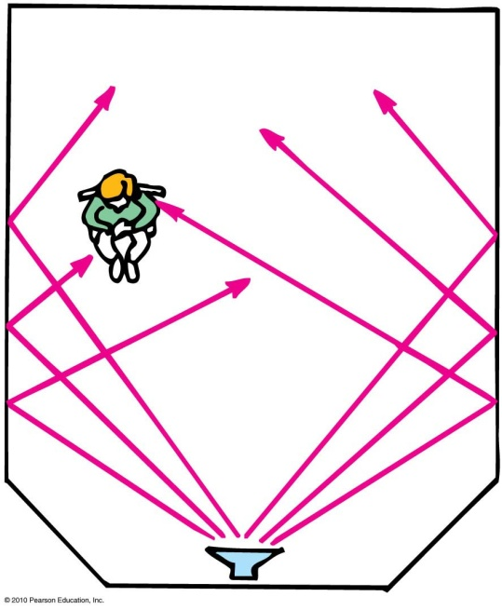
Reflection of Sound
Reflection
Process in which sound encountering a surface is returned
Often called an echo
Multiple reflections—called reverberations

Slide 23
Reverberations are best heard when you sing in a room with
Reflection of Sound
CHECK YOUR NEIGHBOR
A. carpeted walls.
hard-surfaced walls.
open windows.
None of the above.
Notes:
B. hard-surfaced walls.

Slide 24
Reverberations are best heard when you sing in a room with
Reflection of Sound
CHECK YOUR ANSWER
A. carpeted walls.
hard-surfaced walls.
open windows.
None of the above.
Explanation:
Rigid walls better reflect sound energy. Fabric is absorbent, and open windows let sound energy escape from the room.
Notes:
B. hard-surfaced walls.

Slide 25
Reflection of Sound
A situation to ponder…
Consider a person attending a concert that is being broadcast over the radio. The person sits about 45 m from the stage and listens to the radio broadcast with a transistor radio over one ear and a nonbroadcast sound signal with the other ear. Further suppose that the radio signal must travel all the way around the world before reaching the ear.
Notes:
Put the correct answer here including the letter designation.

Slide 26
Which signal will be heard first?
A situation to ponder…
CHECK YOUR NEIGHBOR
A. Radio signal
Nonbroadcast sound signal
Both at the same time.
None of the above.
Notes:
C. Both at the same time.

Slide 27
Which signal will be heard first?
A situation to ponder…
CHECK YOUR ANSWER
A. Radio signal
Nonbroadcast sound signal
Both at the same time.
None of the above.
Explanation:
A radio signal travels at the speed of light, 3 × 10⁸ m/s.
Time to travel 45 m at 340 m/s ≈ 0.13 s.
Time to travel 4 × 10⁷ m (Earth’s circumference) at
3 × 10⁸ m/s ≈ 0.13 s. Therefore, if you sit farther back at the concert, the radio signal would reach you first!
Notes:
C. Both at the same time.

Slide 28
Speed of sound in the Body
The following table shows some densities and sound speeds of tissue in the human body.
The two medium properties, density and sound speed, are combined to define the characteristic acoustic impedance, Z, of the tissue. Z = ρ v
So, another way to define an interface for sound is to say that there is an abrupt change in the characteristic acoustic impedance.
Tissue | v [m/s] | ρ [kg/m3]
Muscle along fib | 1576 | 1,058
Muscle across fib | 1592 | 1,058
liver | 1570 | 1,055
kidney | 1560 | 1,055
brain | 1520 | 1,032
fat | 1476 | 928
bone | 3360 | 2,320
The Physics of Imaging the Human Body

Slide 29
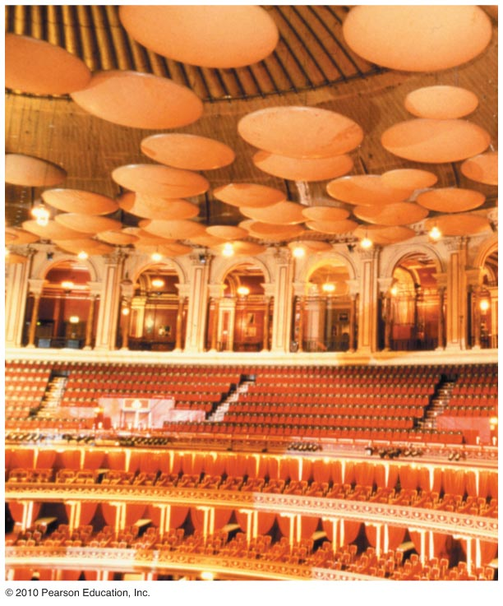
Reflection of Sound
Acoustics
Study of sound is called acoustics
Example: A concert hall aims for a balance between reverberation and absorption. Some have reflectors to direct sound (which also reflect light—so what you see is what you hear).

Slide 30
Reflection of Sound
The reflection of sound is called an echo.
The reflection of sound from a surface is dependent on how rigid and smooth the surface is.
More sound energy is absorbed by a soft rough surface.
When the walls, ceiling and floor of a room or hall are too reflective the sound is garbled.
The multiple reflection of sound is called reverberation. The loss of sound is called absorption. Designing concert halls or auditoriums is the balance of reflection and absorption.

Slide 31
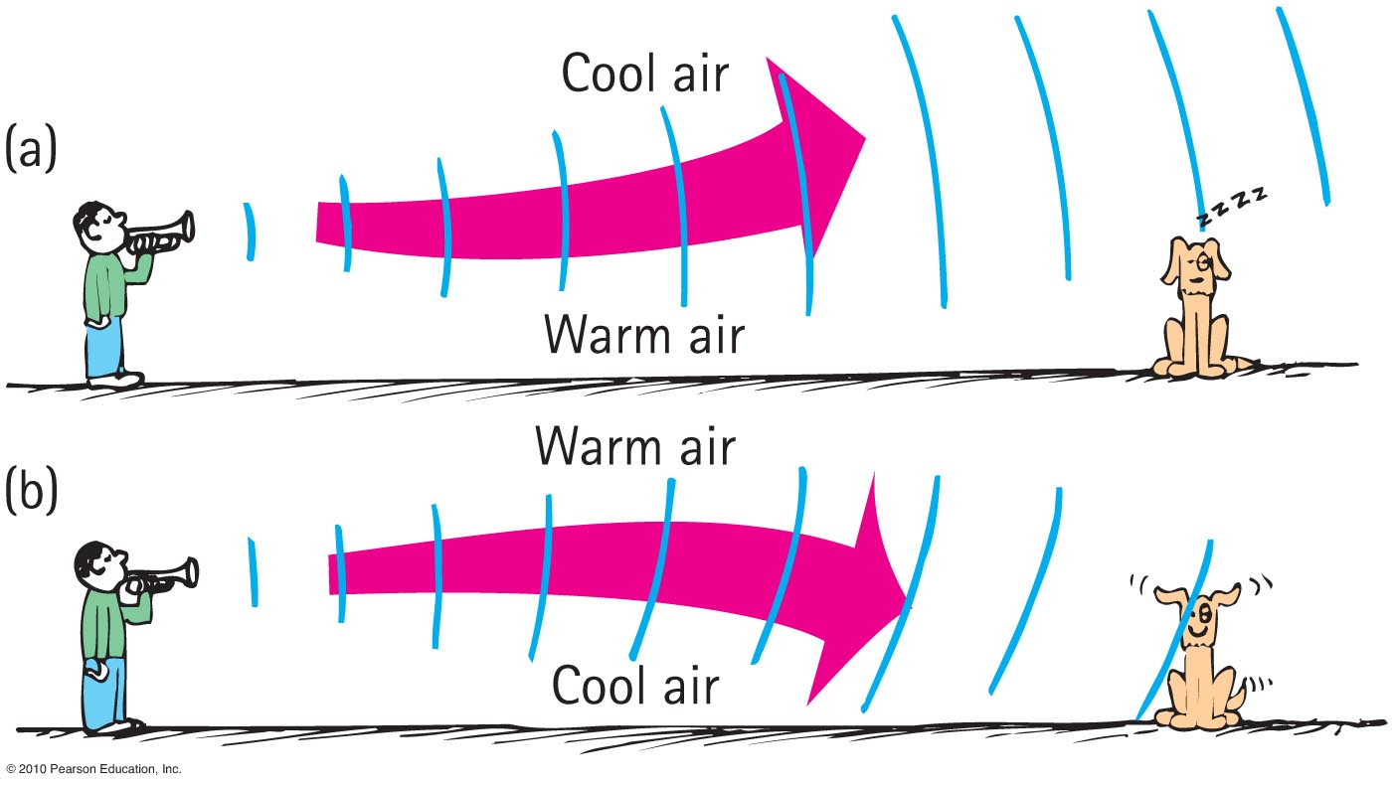
Refraction of Sound
Refraction
Bending of waves—caused by changes in speed affected by
  wind variations.
  temperature variations.

Slide 32
Refraction of Sound
Waves bend or refract when parts of the wave travel at different speeds.
Sound waves bend as they travel from one medium to another with a different density.
Sound waves are refracted when the air (or water) is at different temperatures (or densities).
Multiple reflections and refractions of ultrasonic waves are used to view inside the human body.
The Doppler effect can also be used to detect the heartbeat of a fetus as early as 11 weeks.
Bats and Dolphins use ultrasound to see things in the air or underwater.

Slide 33
When air near the ground on a warm day is warmed more than the air above, sound tends to bend
Refraction of Sound
CHECK YOUR NEIGHBOR
A. upward.
downward.
at right angles to the ground.
None of the above.
Notes:
A. upward.

Slide 34
When air near the ground on a warm day is warmed more than the air above, sound tends to bend
Refraction of Sound
CHECK YOUR ANSWER
A. upward.
downward.
at right angles to the ground.
None of the above.
Notes:
A. upward.

Slide 35
In the evening, when air directly above a pond is cooler than air above, sound across a pond tends to bend
Refraction of Sound
CHECK YOUR NEIGHBOR
A. upward.
downward.
at right angles to the ground.
None of the above.
Notes:
B. downward.

Slide 36
In the evening, when air directly above a pond is cooler than air above, sound across a pond tends to bend
Refraction of Sound
CHECK YOUR ANSWER
A. upward.
downward.
at right angles to the ground.
None of the above.
Explanation:
This is why sound from across a lake at night is easily heard.
Notes:
B. downward.

Slide 37
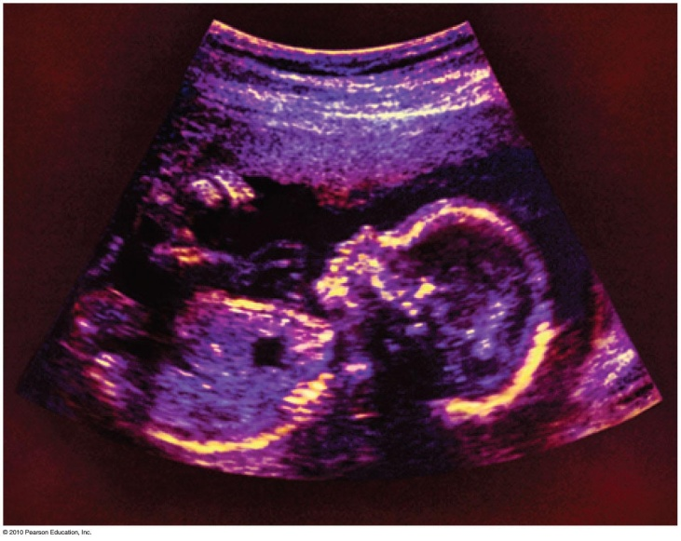
Reflection and Refraction of Sound
Multiple reflection and refractions of ultrasonic waves
  Device sends high-frequency sounds into the body and reflects the waves more strongly from the exterior of the organs, producing an image of the organs.
  Used instead of X-rays by physicians to see the interior of the body.

Slide 38
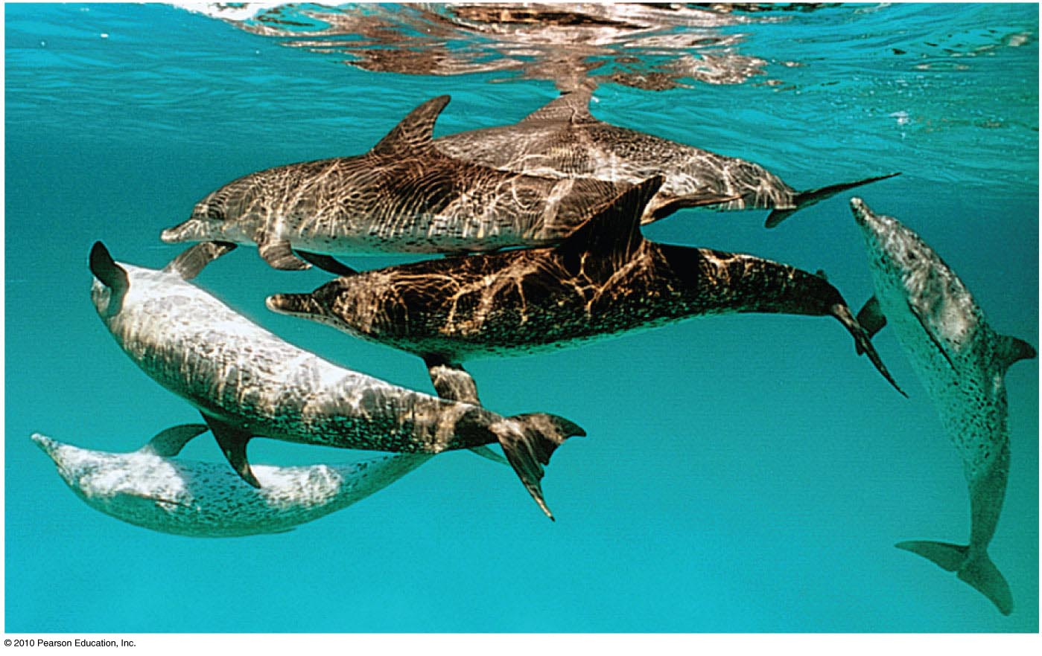
Reflection and Refraction of Sound
Dolphins emit ultrasonic waves to enable them to locate objects in their environment.

Slide 39
Forced Vibrations
Forced vibration
Setting up of vibrations in an object by a vibrating force
Example: factory floor vibration caused by running of heavy machinery

Slide 40
Natural Frequency
Natural frequency
Own unique frequency (or set of frequencies)
Dependent on
  elasticity
  shape of object

Slide 41
Resonance
A phenomenon in which the frequency of forced vibrations on an object matches the object’s natural frequency
Examples:
  Swinging in rhythm with the natural frequency of a swing
  Tuning a radio station to the “carrier frequency” of the radio station
  Troops marching in rhythm with the natural frequency of a bridge (a no-no!)

Slide 42
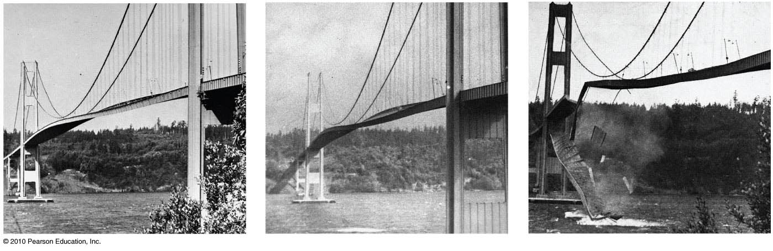
Resonance
Dramatic example of wind-generated resonance

Slide 43
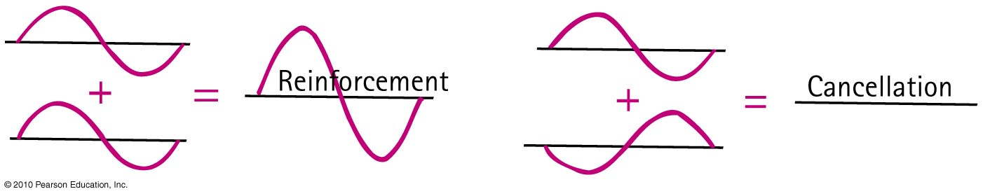
Interference
Interference
Property of all waves and wave motion
Superposition of waves that may either reinforce or cancel each other

Slide 44
Interference is a property of
Interference
CHECK YOUR NEIGHBOR
A. sound.
light.
Both A and B.
Neither A nor B.
Notes:
C. Both A and B.

Slide 45
Interference is a property of
Interference
CHECK YOUR ANSWER
A. sound.
light.
Both A and B.
Neither A nor B.
Explanation:
See Figure 12.21 for illustrations of both light and sound interference. Interestingly, the presence of interference tells a physicist whether something is wavelike. All types of waves can interfere.
Notes:
C. Both A and B.

Slide 46
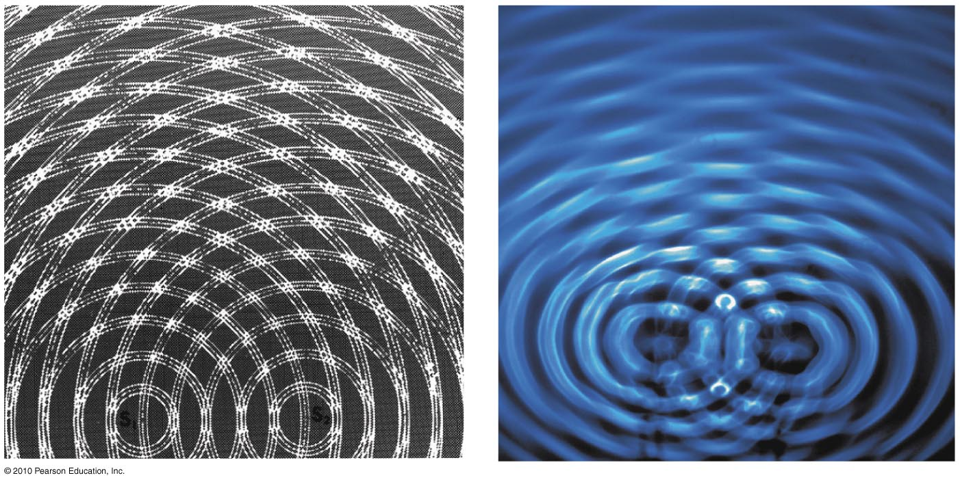
Interference
Two patterns of interference
Constructive interference
  increased amplitude when the crest of one wave overlaps the crest of another wave
Destructive interference
  reduced amplitude when the crest of one wave overlaps the trough of another wave

Slide 47
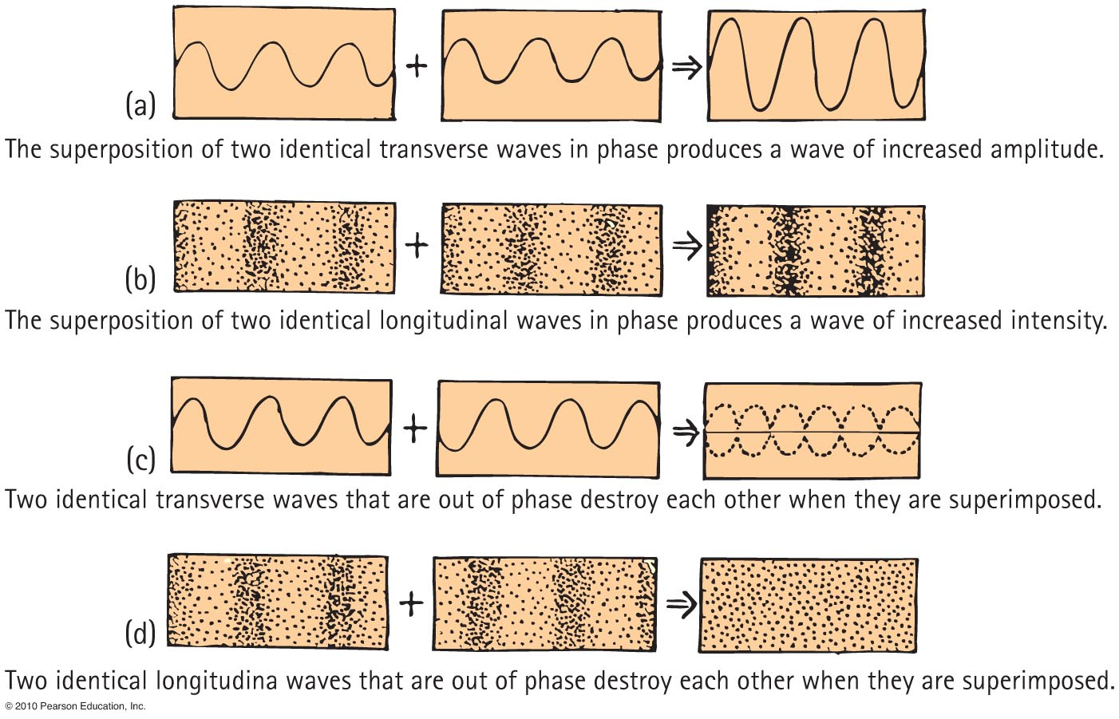
Interference

Slide 48
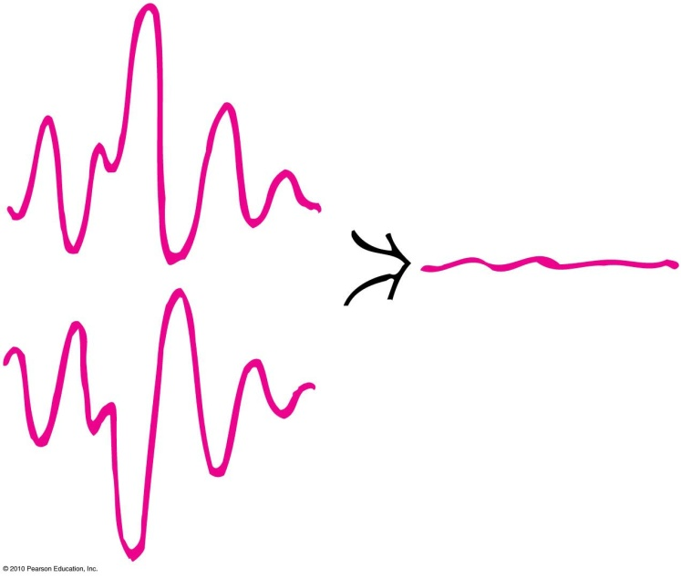
Interference
Application of sound interference
Destructive sound interference in noisy devices such as jackhammers that are equipped with microphones to produce mirror-image wave patterns fed to operator’s earphone, canceling the jackhammer’s sound

Slide 49
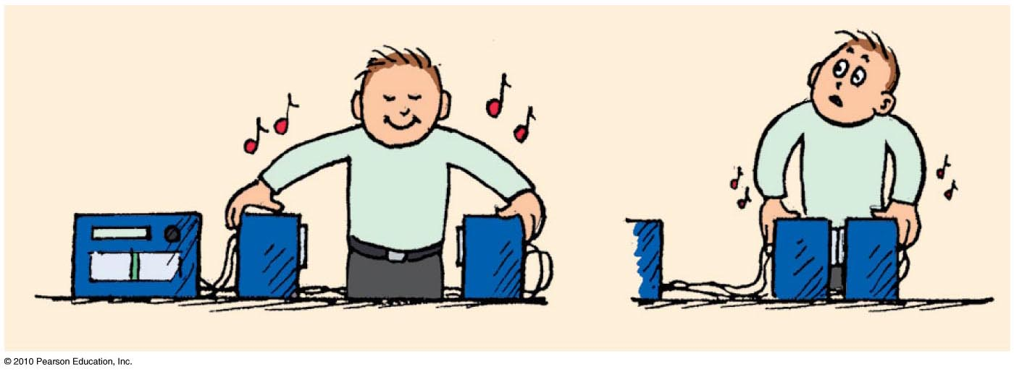
Interference
Application of sound interference (continued)
Sound interference in stereo speakers out of phase sending a monoaural signal (one speaker sending compressions of sound and other sending rarefactions)
As speakers are brought closer to each other, sound is diminished.

Slide 50
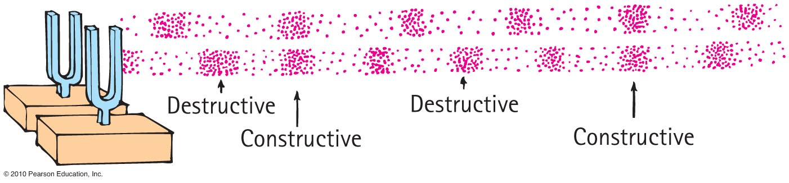
Beats
Periodic variations in the loudness of sound due to interference
Occur with any kind of wave
Provide a comparison of frequencies

Slide 51
Beats
Applications
  Piano tuning by listening to the disappearance of beats from a tuning fork and a piano key
  Tuning instruments in an orchestra by listening for beats between instruments and piano tone

